Slide 1
Capstone Project – CelebA Dataset
U3244821
Friday week 13 8:30-10:30

Slide 2
Table of contents
Introduction / problem statement
Dataset details
Exploratory Data Analysis (EDA)
Predictive Data Analysis (PDA)
Implementation and Deployment Plan And Status Update

Slide 3
Introduction / Problem Statement
Rise of technology has led to various advancements in artificial intelligence and machine learning
Facial recognition rising to prominence
Increased security
Efficiency
Reduce crime

Slide 4
Dataset Details
202599 face images of various celebrities
10177 unique identities
40 binary attributes annotations per image
5 landmark locations
Data files:
Zip folder containing all the face images
CSV file containing recommended partitioning of images into training, validation and testing sets
CSV file containing bounding box information for each image
CSV file containing imaging landmarks and their respective coordinates for each images
CSV file containing attribute labels for each image

Slide 5
Exploratory Data Analysis Questions
How is the data distributed?
Visualising quantitative data
Basic imaging manipulation (rotating/flipping)
Noise detection and reduction
Understanding illumination and lighting artefacts by examining the camera effects/exposure of an image

Slide 6
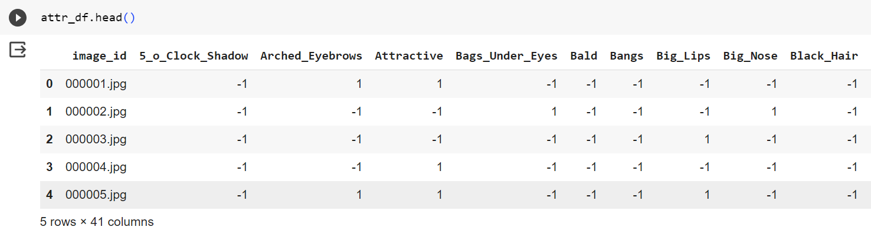
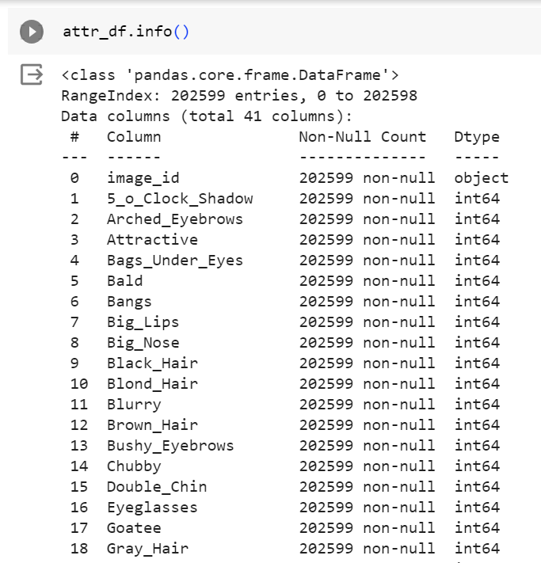
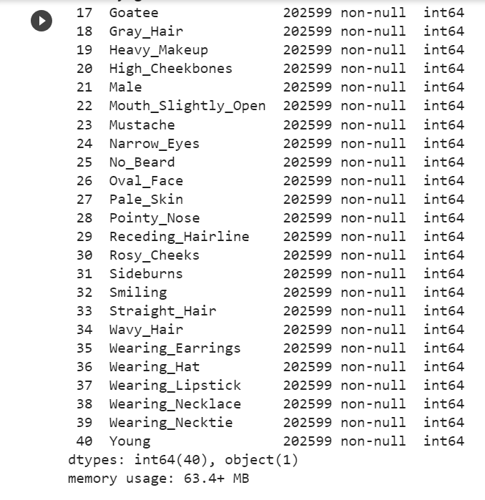
How is the data distributed?

Slide 7
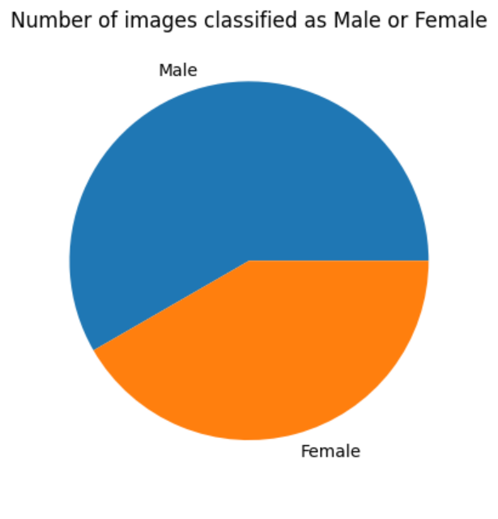
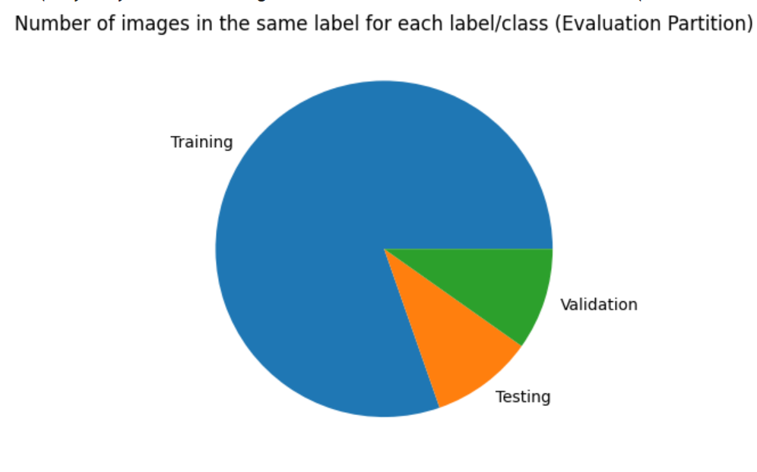
Visualising quantitative data

Slide 8
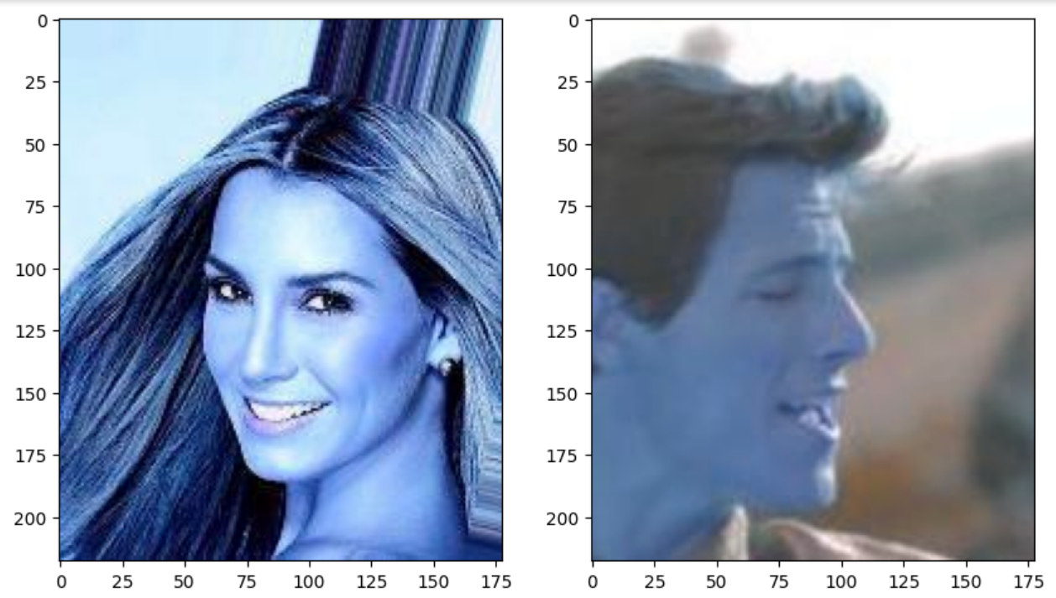
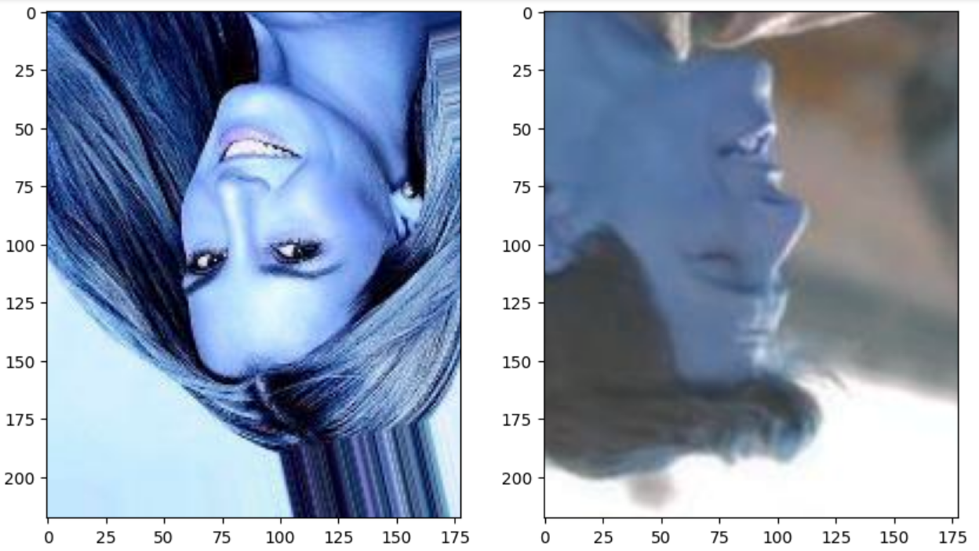
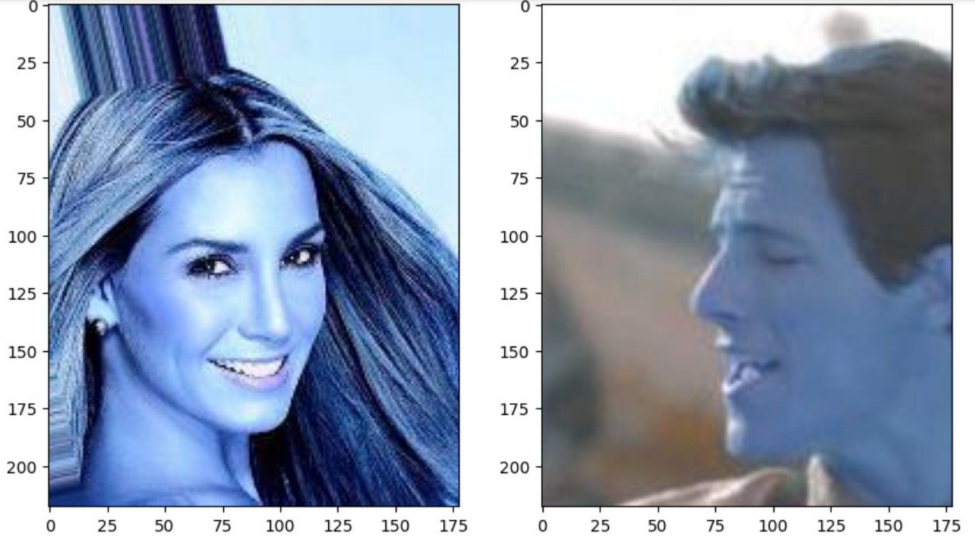
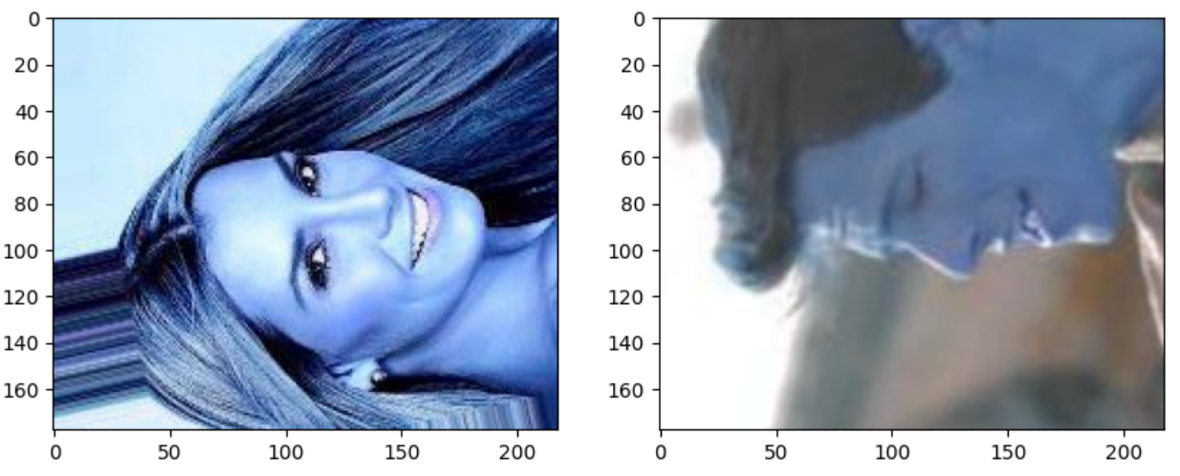
Basic imaging manipulation

Slide 9
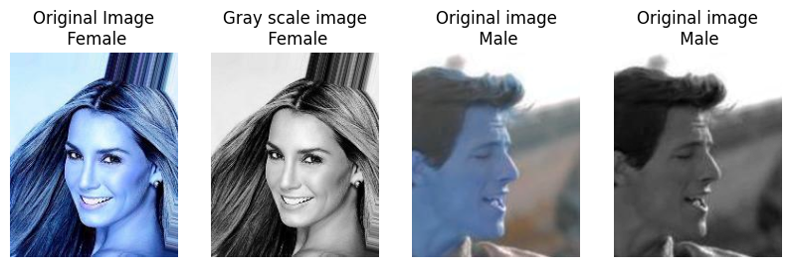
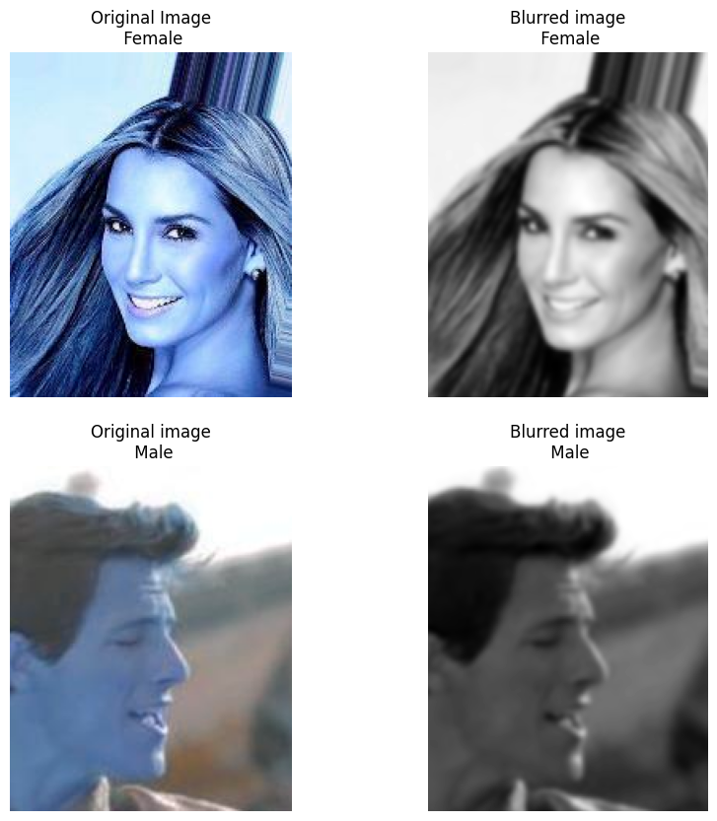
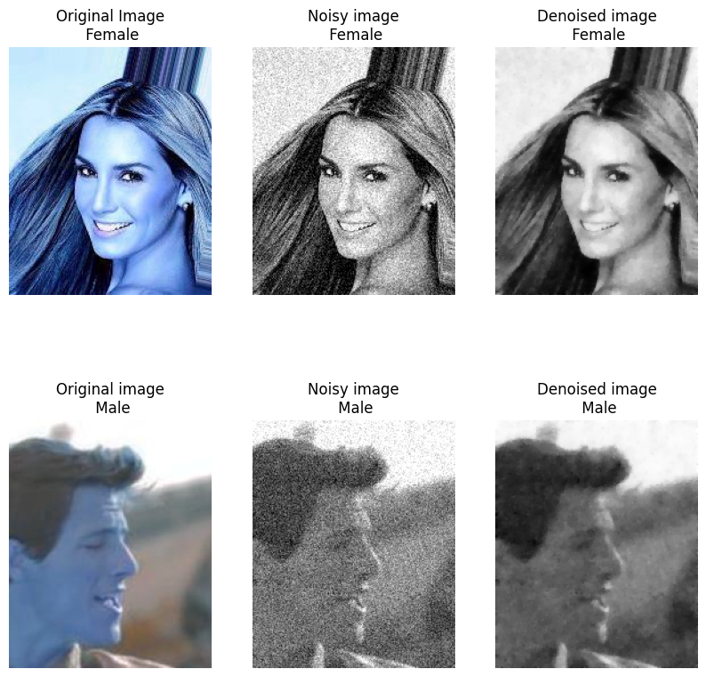
Noise detection and reduction

Slide 10
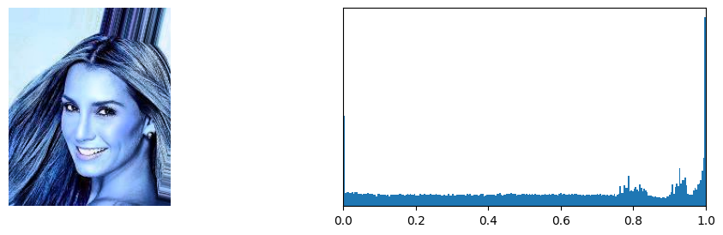
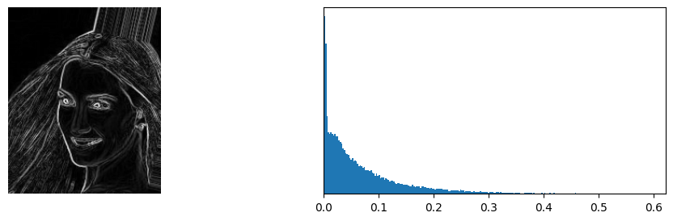

Understanding illumination and lighting artefacts by examining the camera effects/exposure of an image

Slide 11
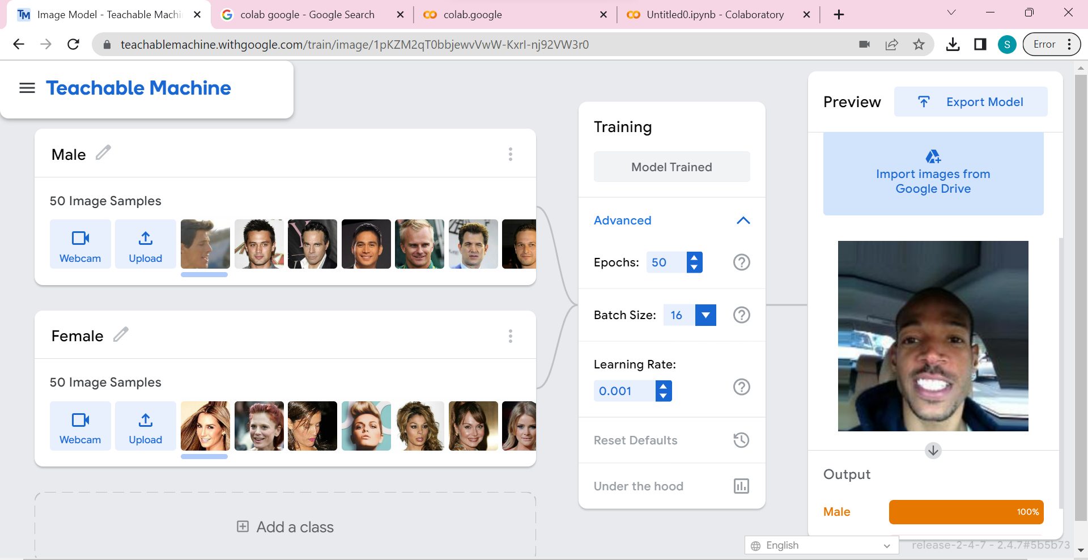
Predictive Data Analysis Outcomes

Slide 12
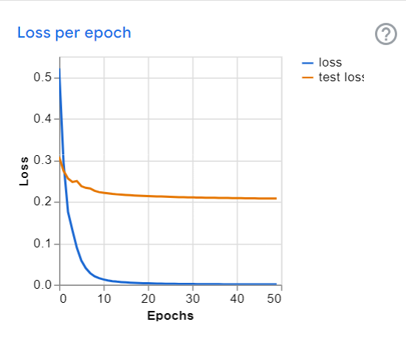
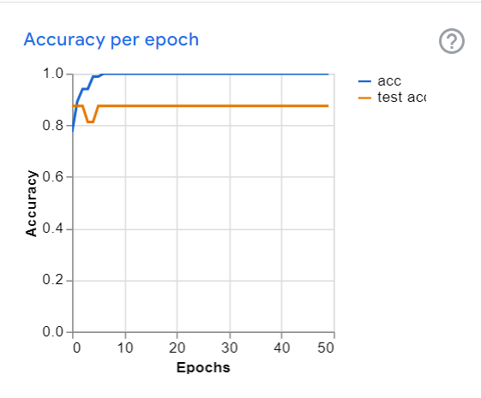
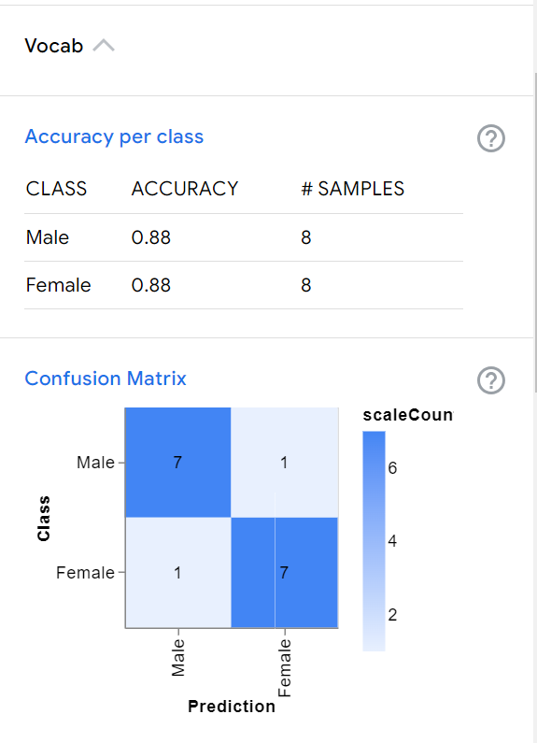
Predictive Data Analysis Outcomes

Slide 13
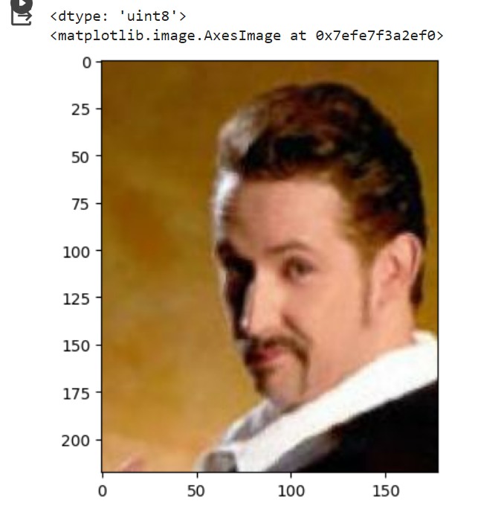
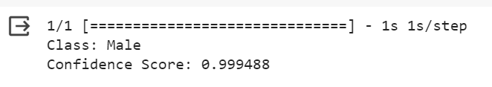
Implementation and Deployment

Slide 14
Thank you.

